Slide 1
Java Conditional/Control Statements Examples, Java Conditional/Control Loops, Jump Statements, and Examples.
-Pranali chougule

Slide 2
Java Control Statements
Control statements in Java are instructions that manage the flow of execution of a program based on certain conditions.
They are used to make decisions, to loop through blocks of code multiple times, and to jump to a different part of the code based on certain conditions.
Control statements are fundamental to any programming language, including Java, as they enable the creation of dynamic and responsive programs.
Types of control statements in Java:
Branching / Decision Making Statements.
Loops / Iteration / Repetition Statements.
Jumping / Transfer Statements.

Slide 3
Control statements
Decision making
Looping
Jumping
while
break
if
Do while
If-else
continue
switch
for
return
For each
Nested if-else

Slide 4
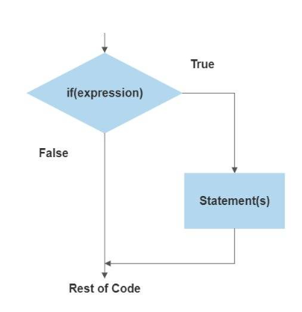
1.Decision Making
If :
The if statement in java evaluates a boolean condition.
If the condition is true, the block of code inside the if statement is executed.
It's the simplest form of decision-making in programming, allowing for the execution of certain code based on a condition.
Syntax Flowchart
if (condition) { // Code to execute if the condition is true }
Example
public class Example {
public static void main(String[] args) {
int age = 20;
if (age >= 18) {
System.out.println("You are eligible to vote.");
} }}

Slide 5
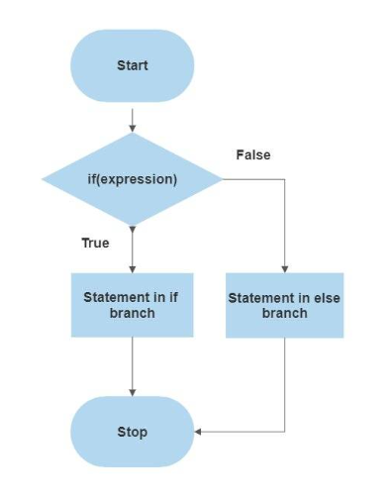
'if-else' Statement in Java
The if-else statement in Java is used for multiple conditions.
It comes after an if statement and before an else statement.
If the if condition is false, the program checks the if-else condition.
If the if-else condition is true, its code block is executed.
Syntax Flowchart
if (condition) { // Code to execute if the condition is true } else { // Code to execute if the condition is false }

Slide 6
Example
public class Example {
public static void main(String[] args) {
int temperature = 30;
if (temperature > 25) {
System.out.println("It's a hot day.");
} else {
System.out.println("It's a cool day.");
}
}
}

Slide 7
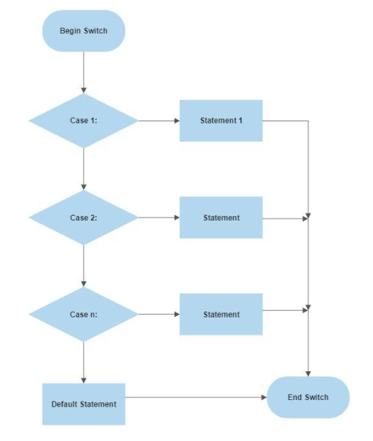
'switch' Statement in Java
The switch statement in Java allows for the selection of a block of code to be executed based on the value of a variable or expression.
It is an alternative to a series of if statements and is often more concise and easier to read.
Syntax Flowchart
switch (expression) { case value1: // Code to be executed if expression equals value1 break; case value2: // Code to be executed if expression equals value2 break; // ... default: // Code to be executed if expression does not
match any case }

Slide 8
Example
public class Example{
public static void main(String[] args) {
char grade = 'B';
switch (grade) {
case 'A':
System.out.println("Excellent!");
break;
case 'B':
System.out.println("Well done!");
break;
case 'C':
System.out.println("Good job!");
break;
default:
System.out.println("Invalid grade.");
break;
}
}
}

Slide 9
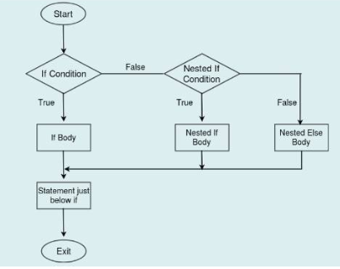
Nested if-else statement
In Java, a nested if-else statement refers to placing an if or if-else structure inside another if or else block
It allows multiple conditions to be tested in sequence.
Syntax Flowchart
if (condition1) {
// Executes if condition1 is true
if (condition2) {
// Executes if condition2 is also true
} else {
// Executes if condition2 is false
}
} else {
// Executes if condition1 is false
if (condition3) {
// Executes if condition3 is true
} else {
// Executes if condition3 is false
}
}
.

Slide 10
Example
public class Example {
public static void main(String[] args) {
int time = 16;
if (time < 12) {
System.out.println("Good morning!");
} else if (time < 18) {
System.out.println("Good afternoon!");
} else {
System.out.println("Good evening!");
}
}
}

Slide 11
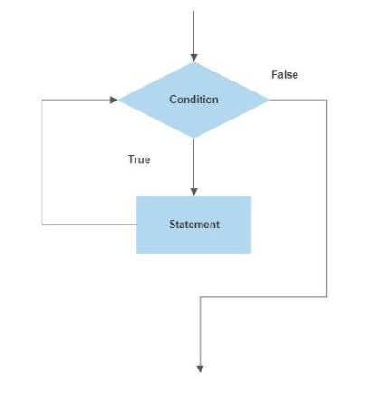
2. Looping Statements
'while loop' in Java
A while loop in Java repeatedly executes a block of code as long as a specified condition remains true.
It is ideal for situations where the number of iterations is not predetermined.
Syntax Flowchart
while (condition) { // code block to be executed }
Here,
Condition: The loop continues to run as
long as this condition evaluates to true.
Code Block: The statements inside the loop execute
repeatedly until the condition becomes false.

Slide 12
Example
public class Example {
public static void main(String[] args) {
int i = 1;
while (i <= 10) {
System.out.println("Square of " + i + " is: " + (i * i));
i++;
}
}
}

Slide 13
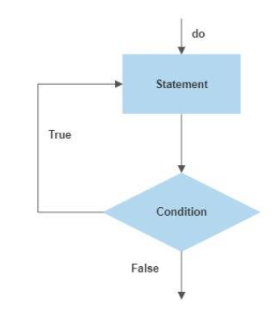
'do-while loop' in Java
The do-while loop in Java is a post-tested loop, meaning it executes the body of the loop at least once before checking the condition.
This loop is useful when you need to ensure that the loop body is executed at least once, regardless of whether the condition is true or false.
After the body of the loop has executed, the condition is tested.
If the condition is true, the loop will execute again. This process repeats until the condition becomes false.
Syntax Flowchart
do { // Statements to execute } while (condition);
Here,
do: This keyword starts the do-while loop.
Statements to execute: These are the actions you want to perform.
This block of code is executed on each iteration of the loop
and it is guaranteed to run at least once.
while: This keyword is followed by a condition in parentheses.
condition: A Boolean expression that is evaluated after the
loop body has executed.
If this condition evaluates to true, the loop will execute again.
If it evaluates to false, the loop will terminate, and control passes
to the statement immediately following the loop.

Slide 14
Example
public class Example {
public static void main(String[] args) {
int num = 3;
int i = 1;
do {
System.out.println(num + " x " + i + " = " + (num * i));
i++;
} while (i <= 10);
}
}

Slide 15
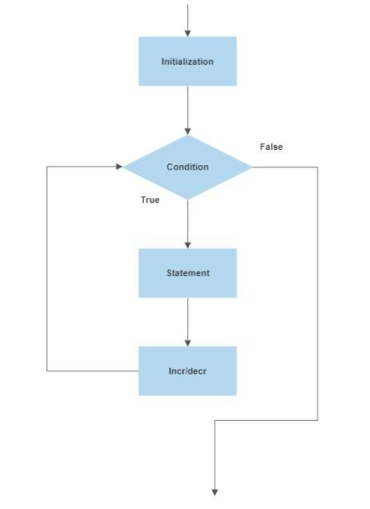
'for loop' in Java
The for loop in Java is a control structure that allows repeated execution of a block of code for a specific number of times.
It is typically used when the number of iterations is known beforehand.
Syntax Flowchart
for (initialization; condition; update) { // code block to be executed }
Here,
Initialization: Typically used to initialize a counter variable.
Condition: The loop runs as long as this condition is true.
Update: Updates the counter variable, usually
incrementing or decrementing.

Slide 16
Example
public class Example {
public static void main(String[] args) {
for (int i = 10; i >= 1; i--) {
System.out.println("Countdown: " + i);
}
}
}

Slide 17
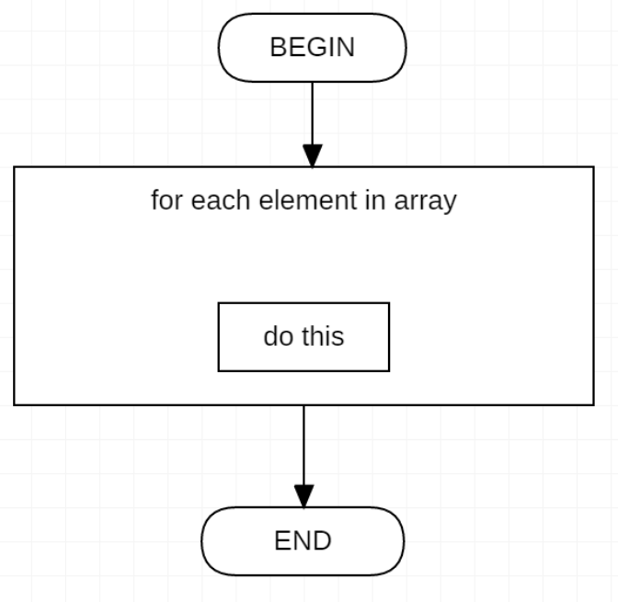
.
'for each loop' in Java
The for-each loop is used to iterate through elements in a collection or array.
It simplifies iteration over arrays or collections like ArrayList, HashSet, etc.
Syntax Flowchart
for (Type element : collection) {
// Code to be executed for each element
}
Type: The data type of the elements in the collection or array.
element: A variable that takes the value of each item
in the collection/array on each iteration.
collection: The array or collection that needs to be looped through
.

Slide 18
Example
import java.util.ArrayList;
public class Example {
public static void main(String[] args) {
ArrayList<String> cars = new ArrayList<>();
cars.add("Tesla");
cars.add("BMW");
cars.add("Audi");
for (String car : cars) {
System.out.println(car);
}
}
}

Slide 19
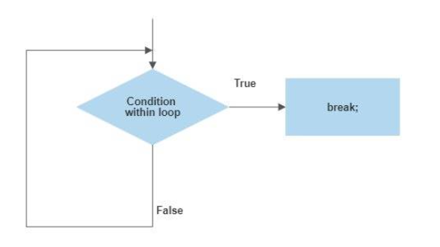
3. Jump Statements
'break' Statement in Java
The break statement is used to exit from a loop (for, while, do-while) or a switch statement.
When encountered, it terminates the loop or switch statement and transfers control to the statement immediately following the loop or switch.
Syntax
break;
Flowchart

Slide 20
Example
public class Example{
public static void main(String[] args) {
int[] numbers = {1, 2, 3, 4, 5, 6, 7, 8, 9, 10};
for (int num : numbers) {
if (num == 7) {
break; // Exit the loop when the number is 7
}
System.out.println(num);
}
}
}

Slide 21
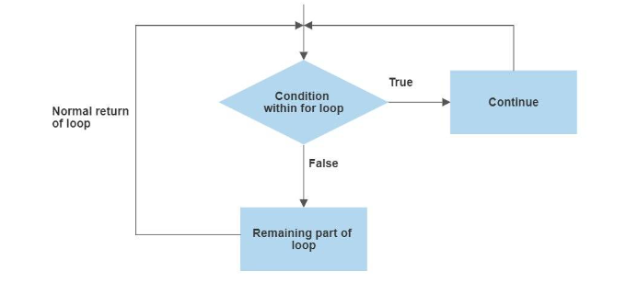
'continue' Statement in Java
The continue statement skips the current iteration of a loop (for, while, do-while) and proceeds to the next iteration.
It effectively jumps to the end of the loop's body and re-evaluates the loop's condition.
Syntax
continue;
Flowchart

Slide 22
Example
public class Example {
public static void main(String[] args) {
for (int i = 1; i <= 10; i++) {
if (i % 2 == 0) {
continue; // Skip even numbers
}
System.out.println(i); // Prints only odd numbers
}
}
}

Slide 23
‘return' Statement in Java
The return statement is used to exit from a method and optionally return a value.
The syntax depends on whether the method returns a value or not.
Syntax
return;
Example
public class Example {
public static void main(String[] args) {
int factorial = calculateFactorial(5);
System.out.println("Factorial of 5 is: " + factorial);
}
public static int calculateFactorial(int n) {
int result = 1;
for (int i = 1; i <= n; i++) {
result *= i;
}
return result; // Return the calculated factorial
}
}

